Slide 1

Applied Statistics
Michał Wilkosz
Filip Uherek
Data: New York City Airbnb Open Data

Slide 2

Description
1. About dataset
Since 2008, guests and hosts have used Airbnb to expand on traveling possibilities and present more unique, personalized way of experiencing the world. This dataset describes the listing activity and metrics in NYC, NY for 2019.
This data file includes all needed information to find out more about hosts, geographical availability, necessary metrics to make predictions and draw conclusions.
Goal
Predict NYC Airbnb Rental Prices

Slide 3
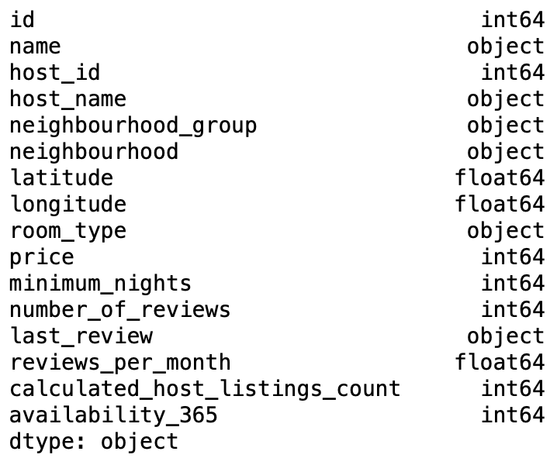
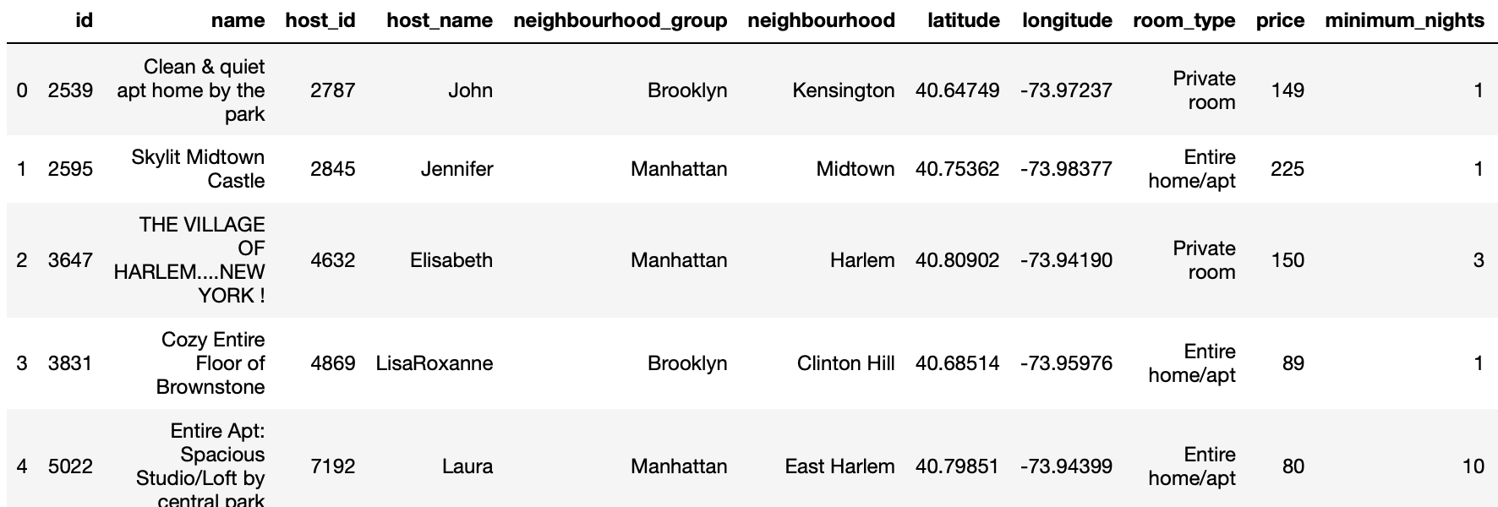
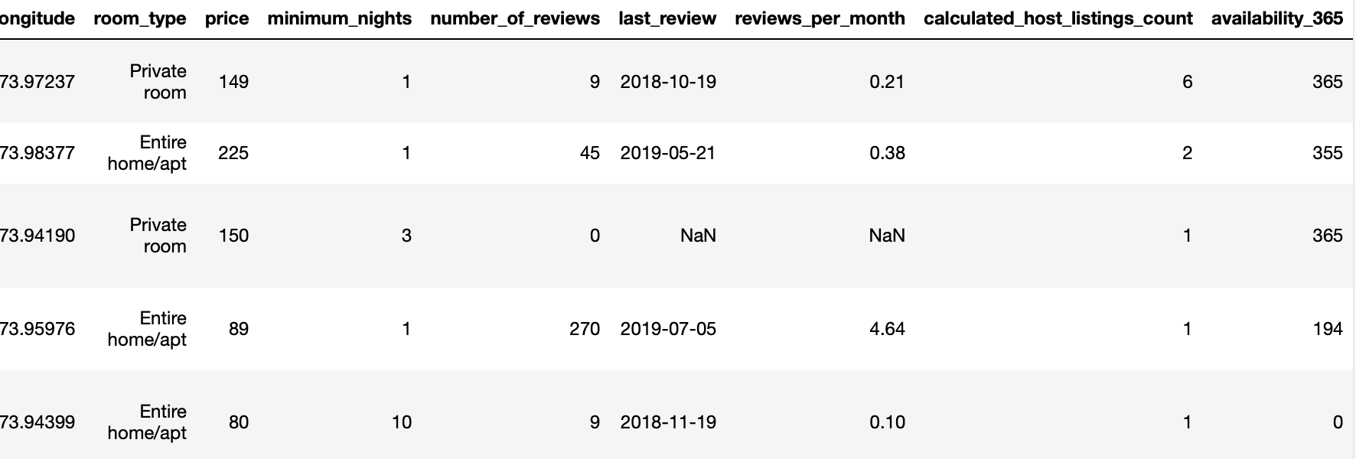
Data shape
2. Dataset overview
Columns in dataset
Dataset contains 48895 samples of 16 features
Number of quantitative features: 10
Number of qualitative features: 6
Quick preview of data

Slide 4
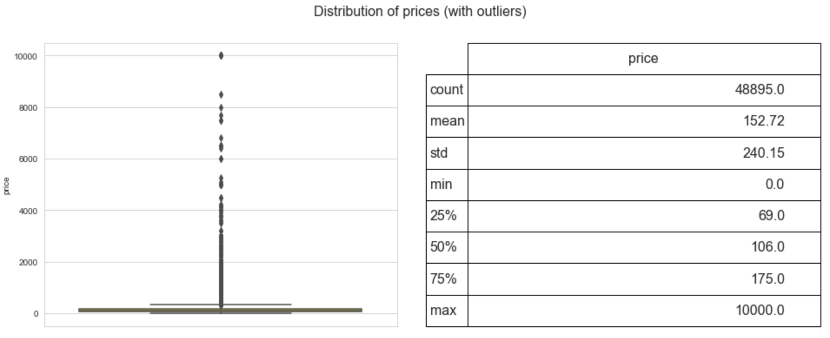
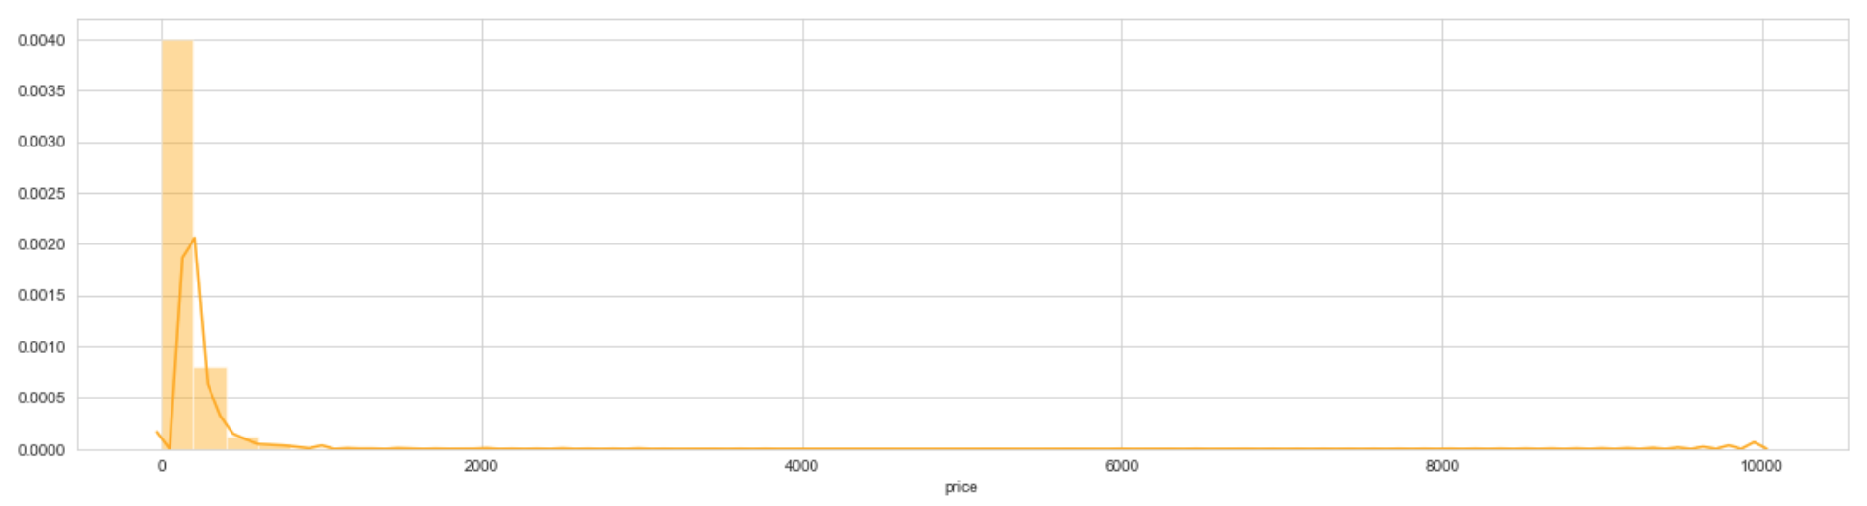
Description
3. Target inspection
The aim of project is to predict the prices of advertisements. Therefore, work on the project started with an inspection of the price distribution.
Distribution of rental price is:
Deviating from normal distribution.
Having appreciable positive skewness.
Showing peakdness.
Skewness: 19.12 Kurtosis: 585.67

Slide 5
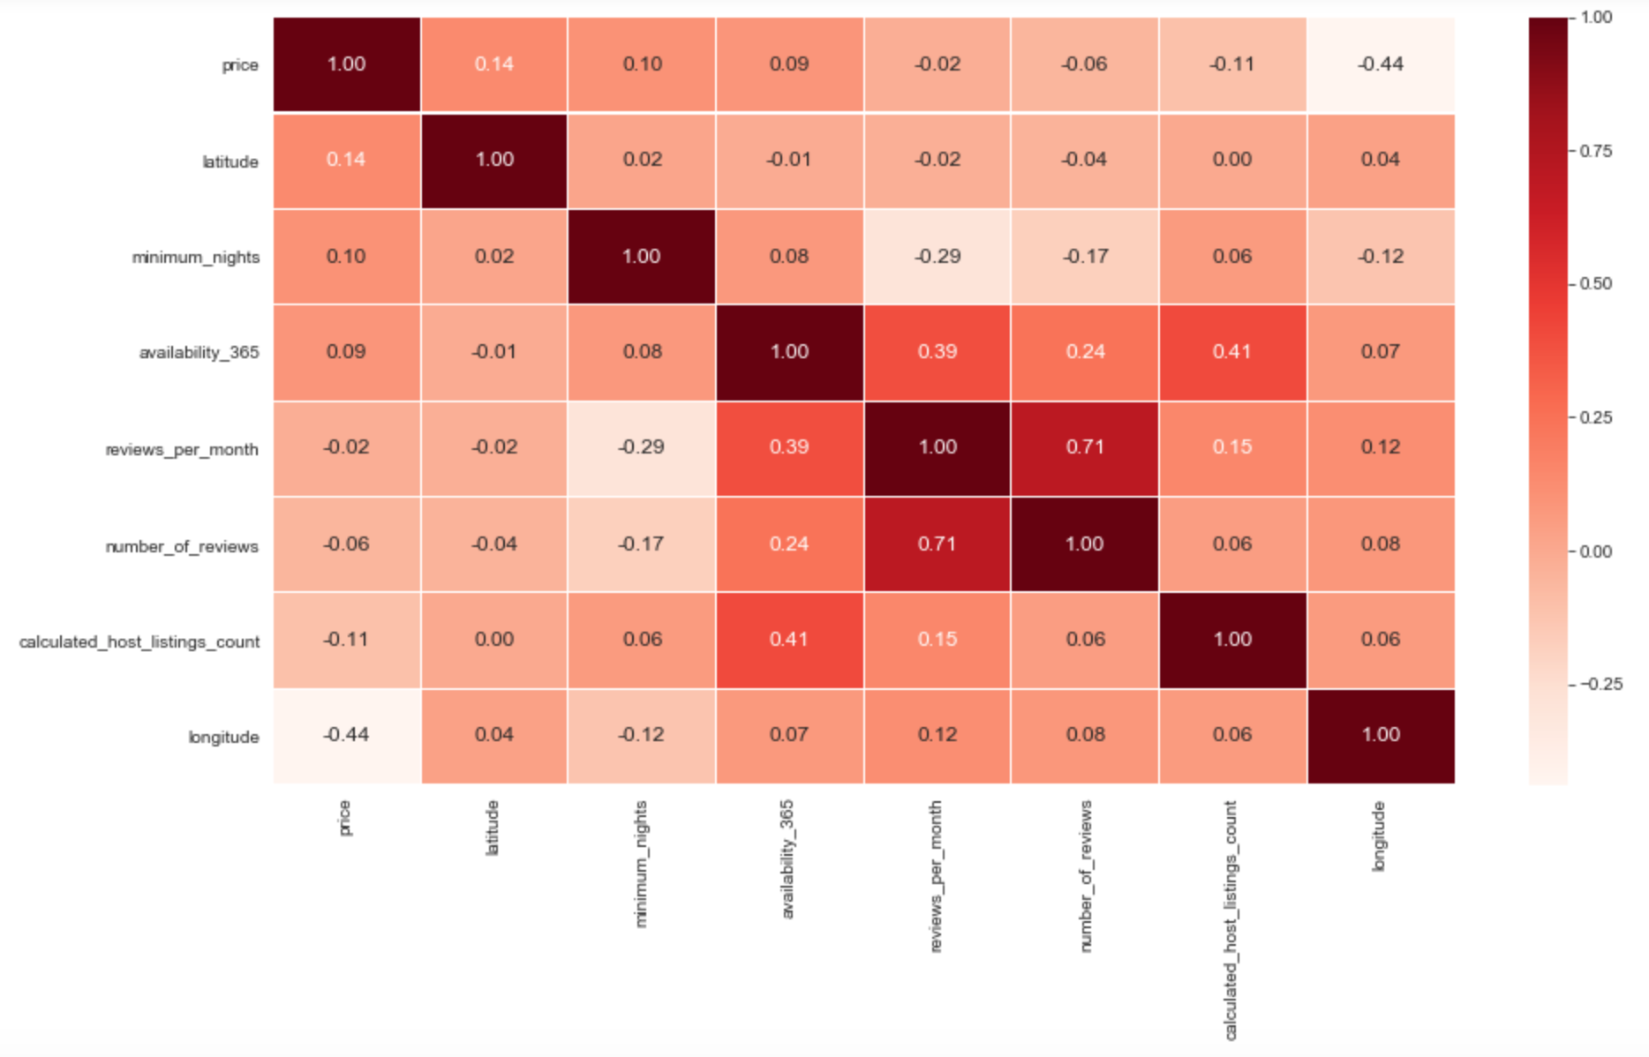
4. Correlation plot
Correlations(spearman) between quantitative features and target - 'price'.

Slide 6
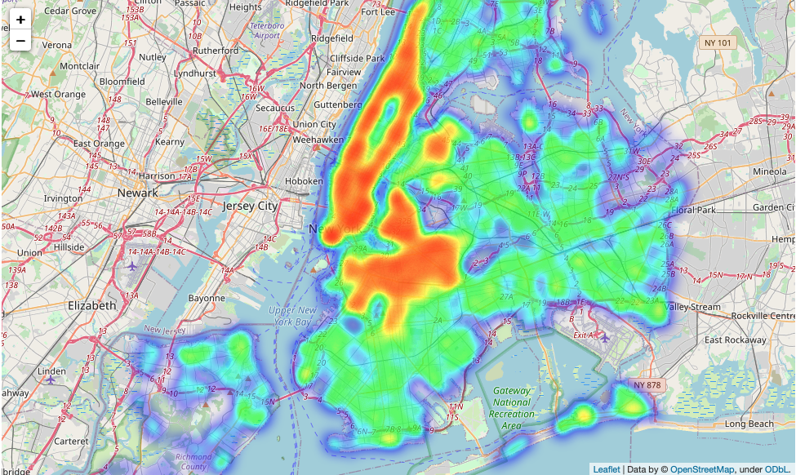
Visualization 1: Distribution of accommodations through heatmap
5. Entry visualizations

Slide 7
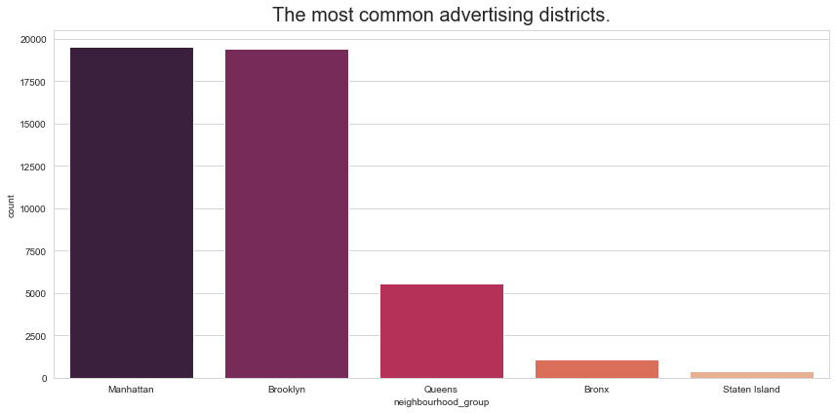
Visualization 2: The most common advertising districts

Slide 8
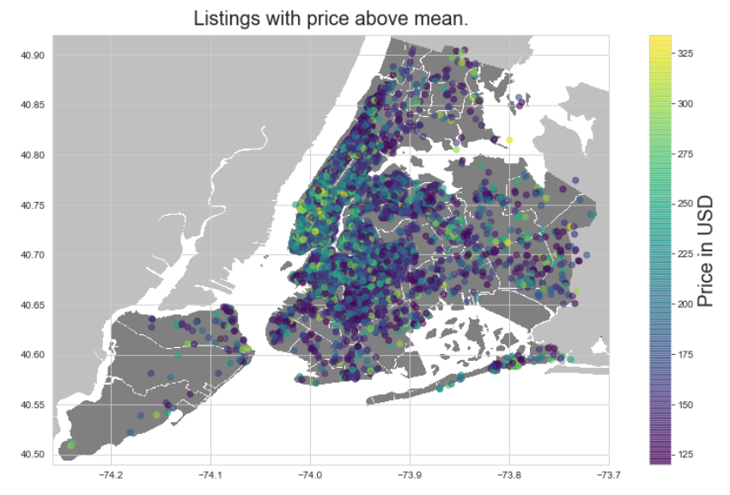
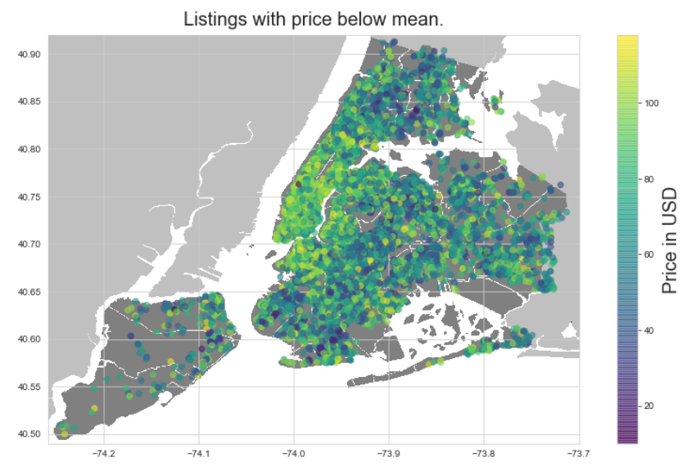
Visualization 3: Prices through districts
Mean price for whole city – 120 USD
Due to the large amount of data, we have divided the distribution of prices below and over mean.

Slide 9
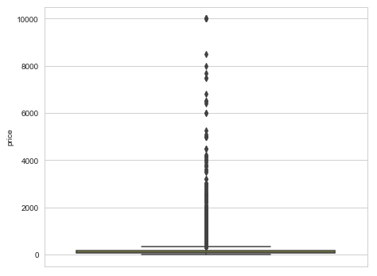
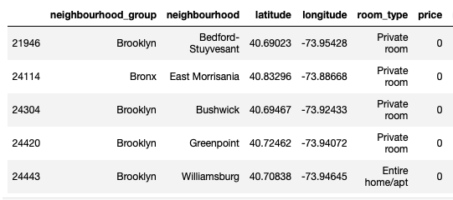
Outliers
6. Cleaning data by target
Based on boxplot of distribution of rental price, it is clear to see that data contains outliers.
To detect outliers on our target - 'price', Tukey rule will be implemented, which defines an interquartile range comprised between the 1st and 3rd quartile of the distribution values (IQR). Outliers are rows whose values are outside IQR.
Zero values in target
Because as we assume that, you cannot rent a room for free. 0 values in target price can affect our estimator as well as outliers, so we have to remove from our data samples whose price is 0.

Slide 10
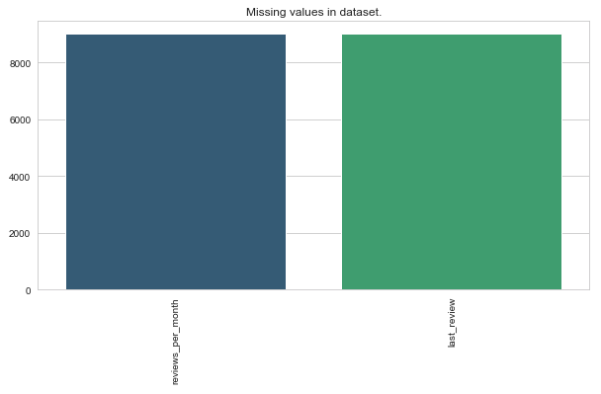
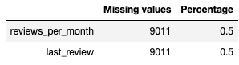
Missing values
Analysing the missing values, we've came to the conclusion that for:
'reviews_per_month' : fill NaN values with 0
'last_reviews’: excluded feature
Commentary: ’last reviews’ feature contributes
nothing that could improve our estimator
After data processing our dataset doesn’t contain any of missing values.
Unnecessary features
Features which have been excluded from dataset
’id’
‘host_id’
‘name’
‘host_name’
The reason for exclusion of these features out of dataset is the absence of any correlation with price.

Slide 11
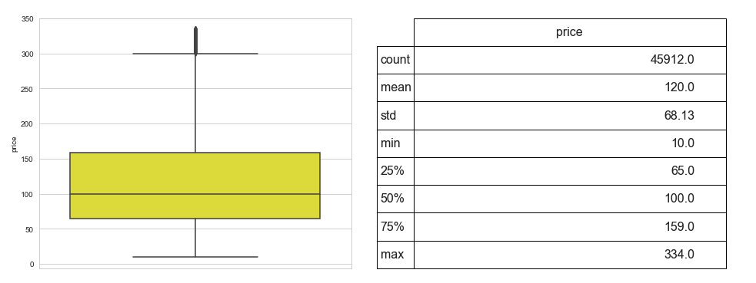
Distribution of price(after Tukey test) and without 0 values.
7. Target distribution after data processing
Commentary: Thanks to the Tukey test and by removing 0 values, distribution of target looks much better.

Slide 12
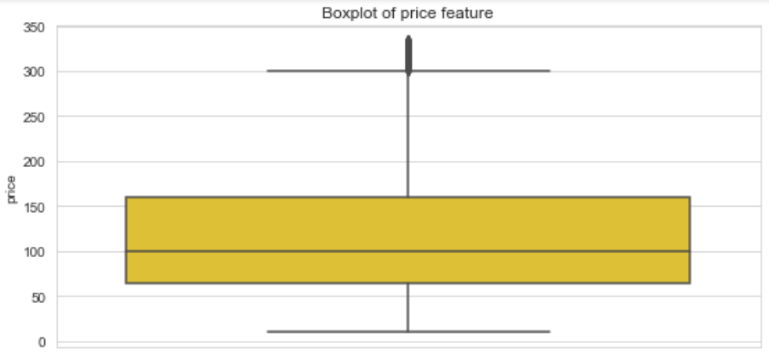
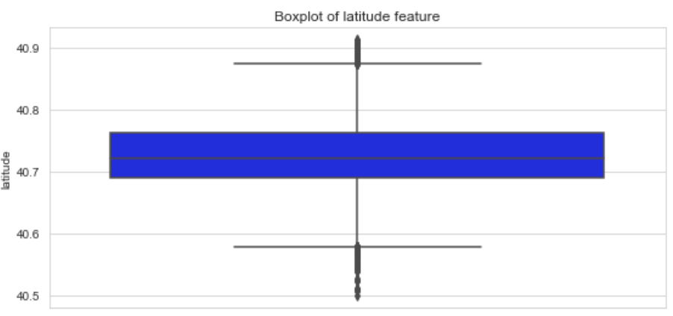
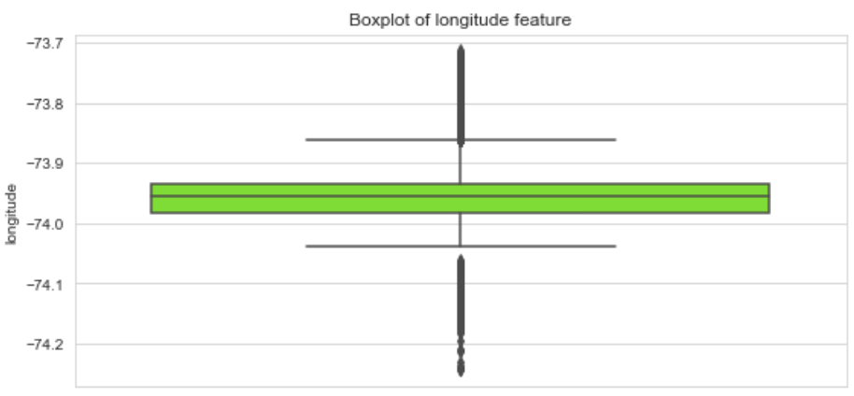
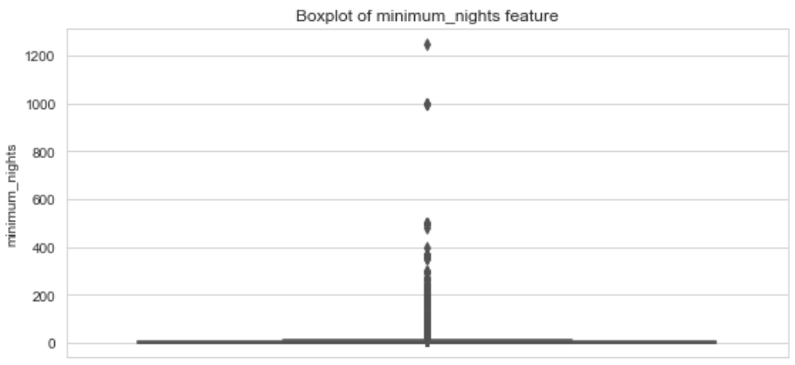
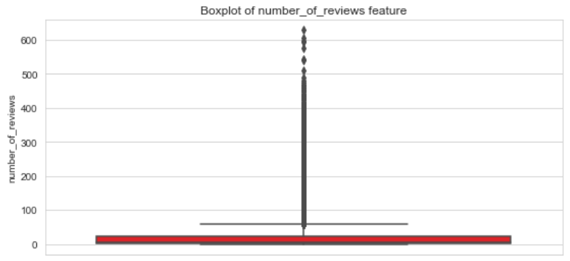
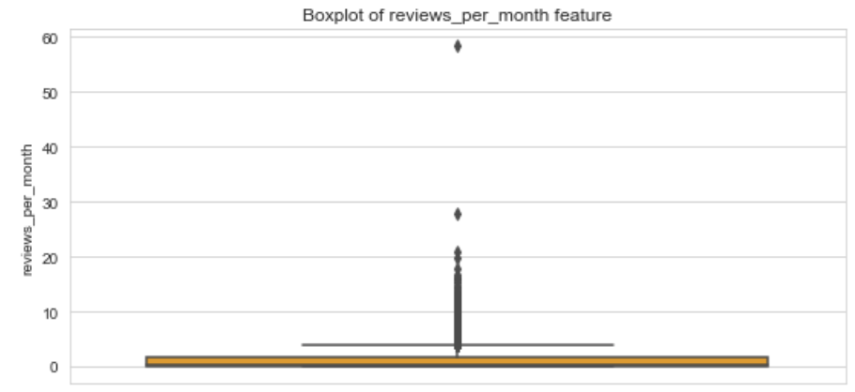
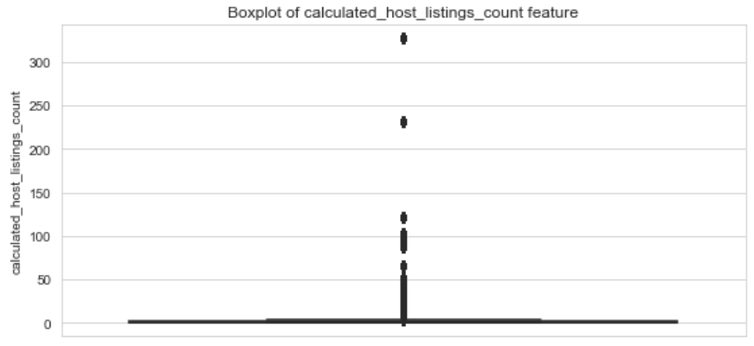
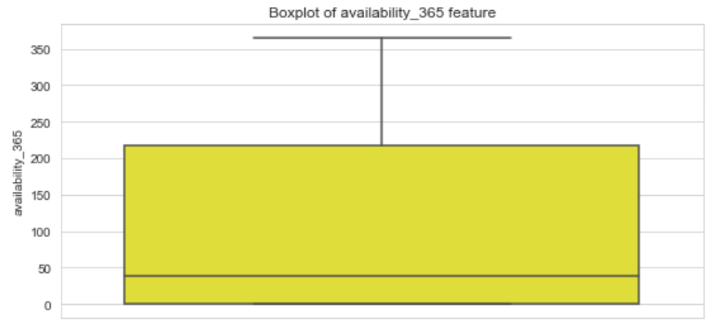
price distribution
8. Distributions of all quantitative features
latitude distribution
longitude distribution
minimum nights distribution
number of reviews distribution
reviews per month distribution
calculated host listings count distribution
availability 365 distribution

Slide 13
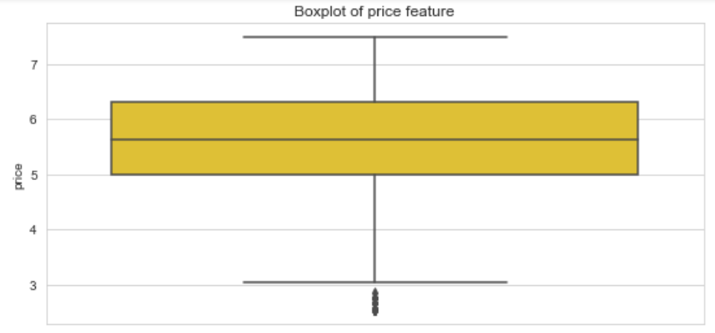
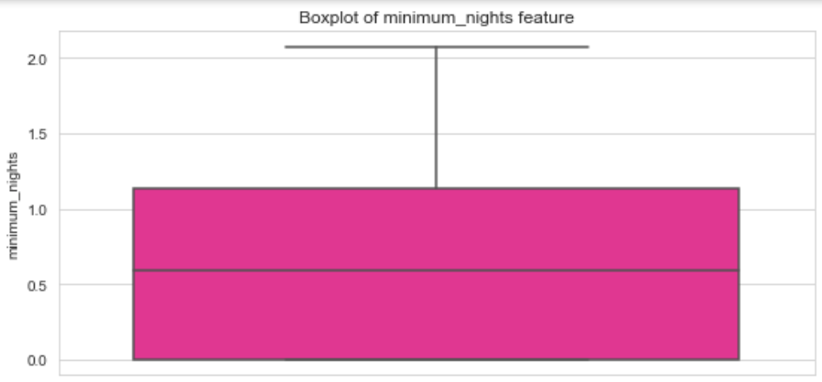
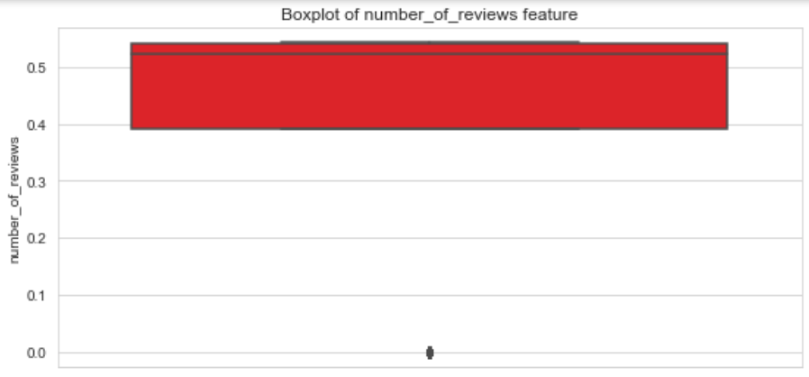
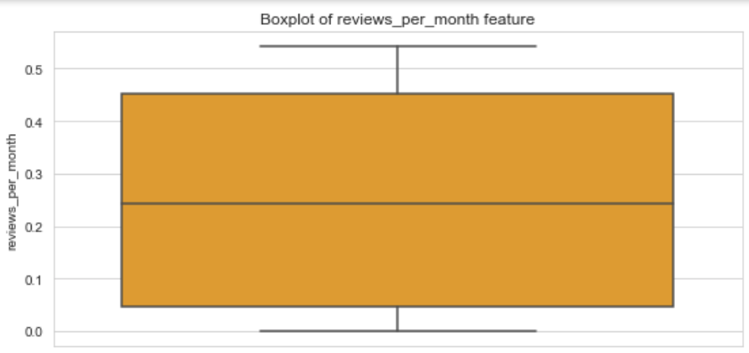
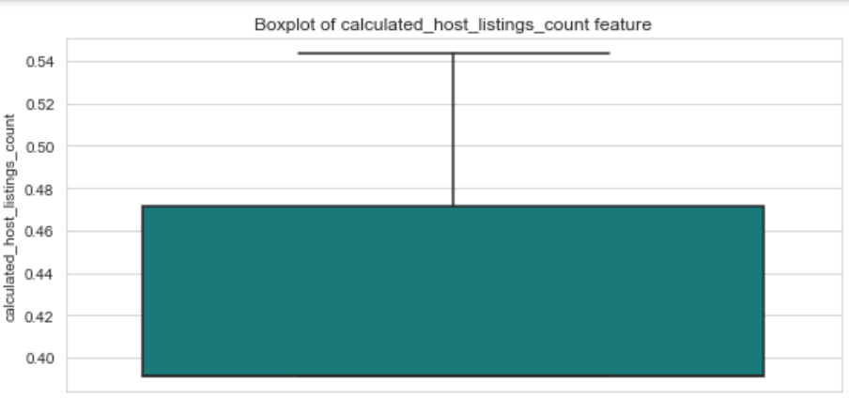
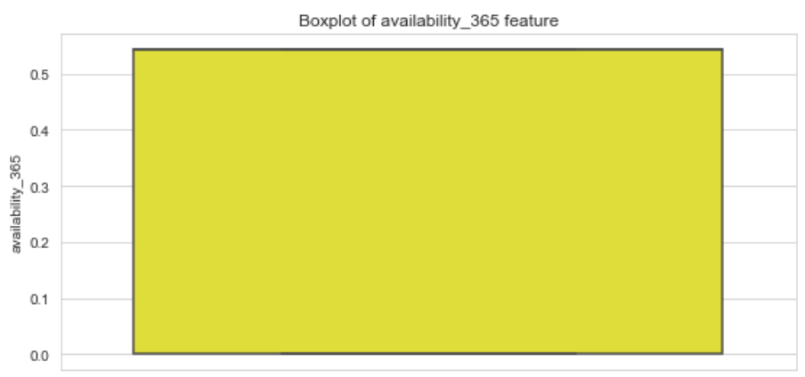
price distribution
9. Solution?
Performing a box-cox transformation to all skewed features.
The transformations carried out have not brought about much improvements
minimum nights distribution
Number of reviews distribution
reviews per month distribution
calculated host listings count distribution
availability 365 distribution

Slide 14
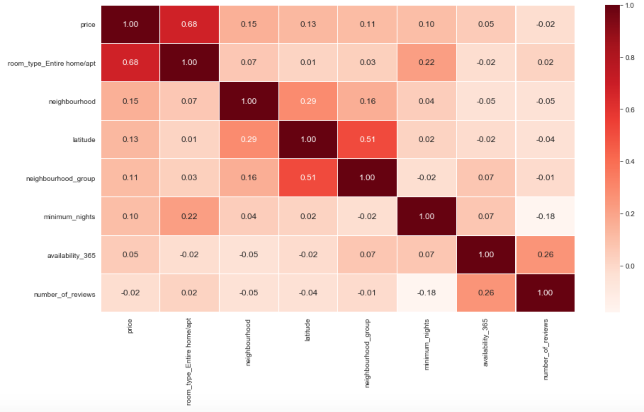
10. Correlation plot
Correlations between quantitative features and target - 'price’ after data transformations and with transformed qualitative features into quantitative ones

Slide 15
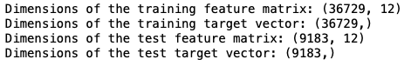
11. Preparing data to predictive models
Metric
For score our models we've used RMSE, because it has the benefit of penalizing large errors.
Train test split
Available data
80% training
20% testing

Slide 16
12. Models
Simple linear regression between particular features and target price.
 | MSE | RMSE | R2 | AIC | BIC
latitude | 0.6527 | 0.8079 | -0.1703 | -4.5305 | -2.5390
longitude | 0.5303 | 0.7282 | 0.0491 | -8.6849 | -6.6934
minimum_nights | 0.6573 | 0.8107 | -0.1786 | -4.3901 | -2.3986
number_of_reviews | 0.6893 | 0.8302 | -0.2360 | -3.4390 | -1.4476
neighbourhood_group | 0.6612 | 0.8131 | -0.1856 | -4.2711 | -2.2797
availability_365 | 0.6759 | 0.8221 | -0.2118 | -3.8339 | -1.8425
neighbourhood | 0.5446 | 0.7379 | 0.0235 | -8.1528 | -6.1613
calculated_host_listings count | 0.6219 | 0.7886 | -0.1151 | -5.4973 | -3.5058
room_type_Entire home/apt | 0.3587 | 0.5989 | 0.3568 | -16.5033 | -14.5119
room_type_Private room | 0.4483 | 0.6695 | 0.1962 | -12.0456 | -10.0541
room_type_Shared room | 0.6279 | 0.7924 | -0.1259 | -5.3049 | -3.3135

Slide 17
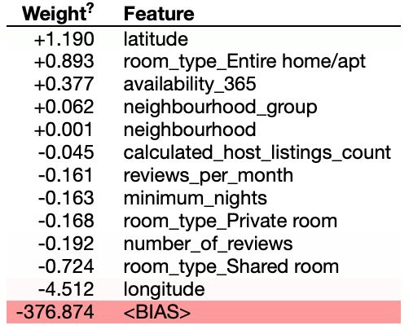
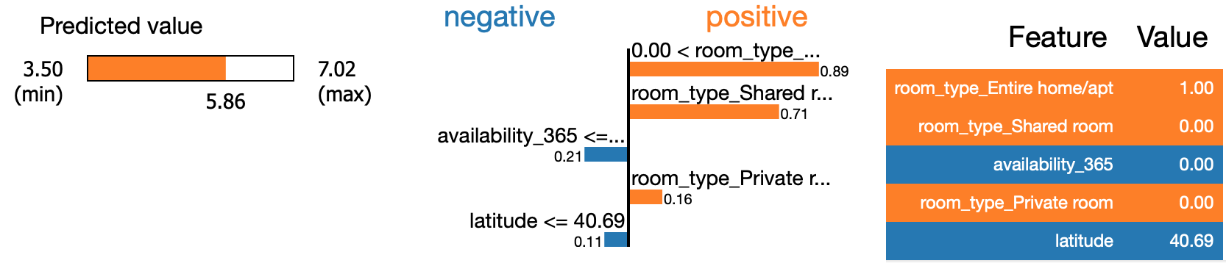
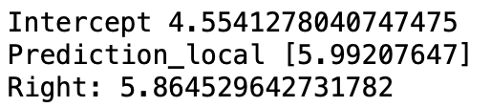
Linear regression
Scores:
Model top features:
 | train | test
RMSE | 0.5871 | 0.5879
MSE | 0.3447 | 0.3456
R2 | 0.5270 | 0.5155
AIC | 52710 | 82071
BIC | 443490 | 409206
Model interpretation for 500th data sample:

Slide 18
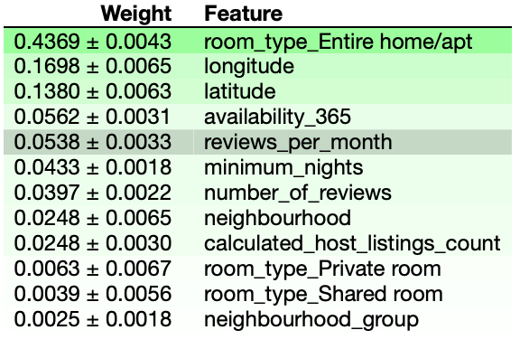
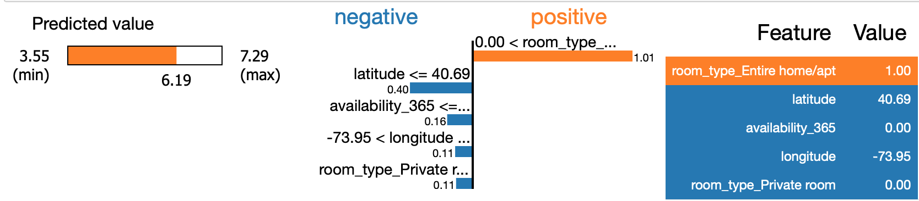
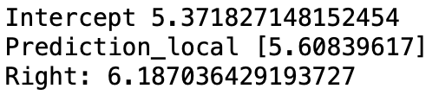
Random forest
Scores:
Model top features:
 | train | test
RMSE | 0.2259 | 0.5341
MSE | 0.0511 | 0.2853
R2 | 0.9299 | 0.6001
AIC | -17437 | 80309
BIC | 373365 | 407444
Model interpretation for 500th data sample:

Slide 19
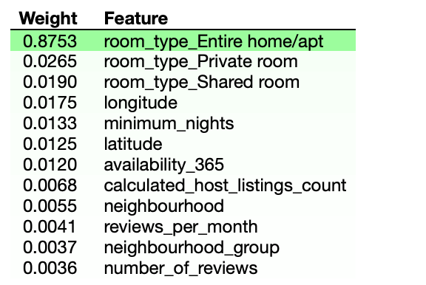
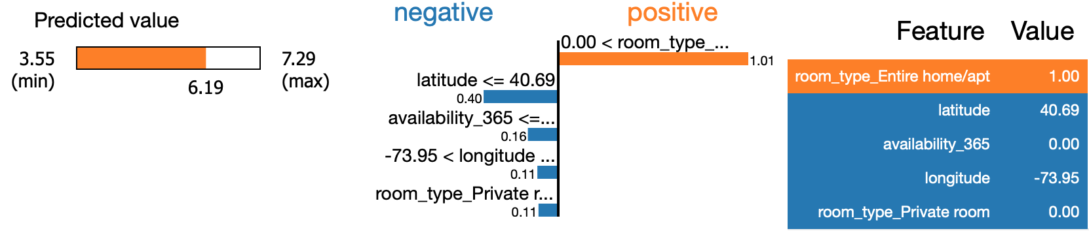
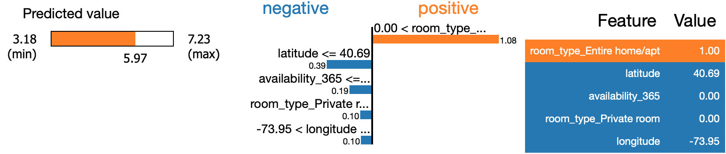
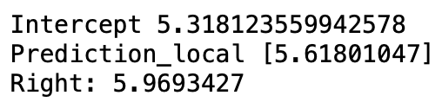
XGBoost regressor
Scores:
Model top features:
 | train | test
RMSE | 0.4918 | 0.5311
MSE | 0.2418 | 0.2821
R2 | 0.6681 | 0.6046
AIC | 39694 | 80205
BIC | 430475 | 407340
Model interpretation for 500th data sample:

Slide 20
13. Models for particular districts
Basing on correlation plot, scores of linear regressions for features and model interpreters, we found that the most important features for models are:
Entire home/apt
Private room
Shared room
Longitude
Latitude
Availability 365
Neighbourhood
Since the price results for the whole city did not yield very good results, we decided to divide our city by districts and try again using only most relevant features.
We rejected the random forest model because of notable overfitting.

Slide 21
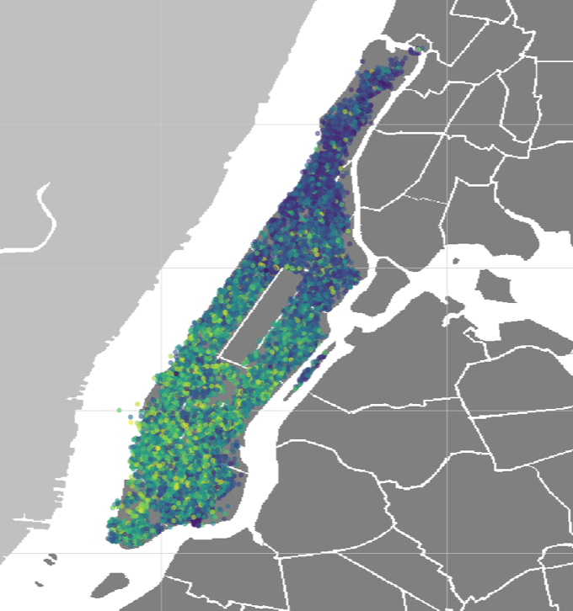
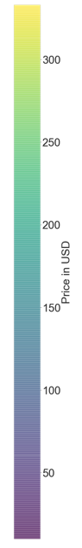
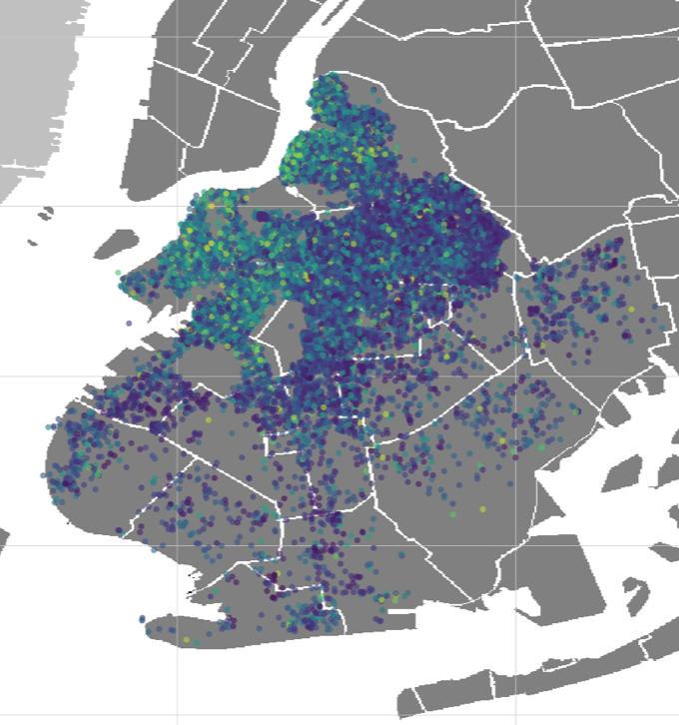
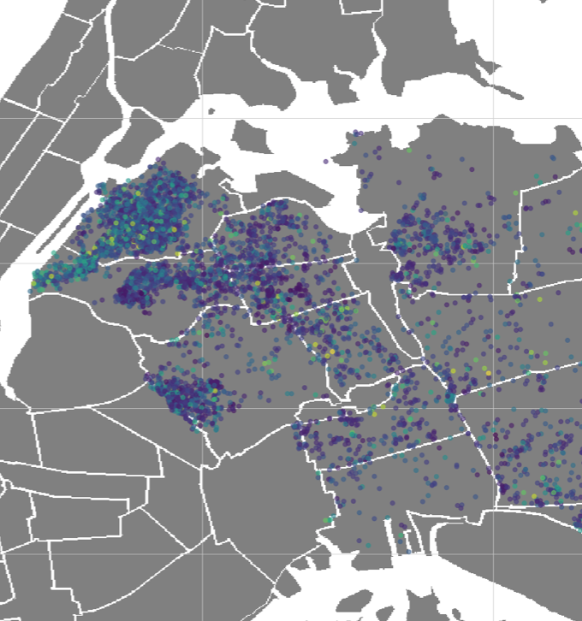
Manhattan
Brooklyn
Queens
mean price: 145.96
mean price: 105.74
mean price: 88.90
 | train | test
Linear regression
RMSE | 52.69 | 52.55
XGBoost regressor
RMSE | 47.37 | 50.97
 | train | test
Linear regression
RMSE | 44.48 | 43.58
XGBoost regressor
RMSE | 39.67 | 42.08
 | train | test
Linear regression
RMSE | 42.67 | 41.47
XGBoost regressor
RMSE | 32.51 | 41.18

Slide 22
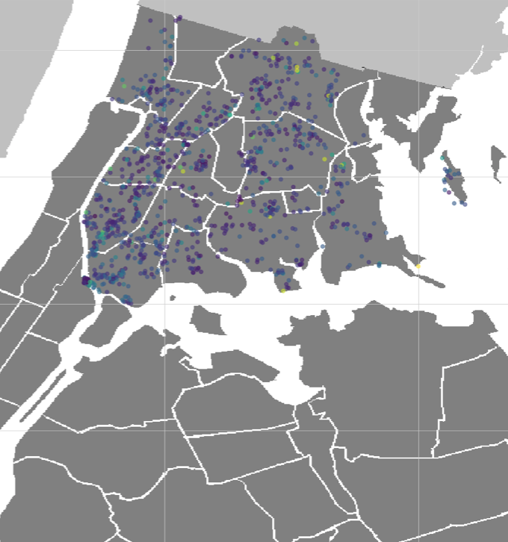
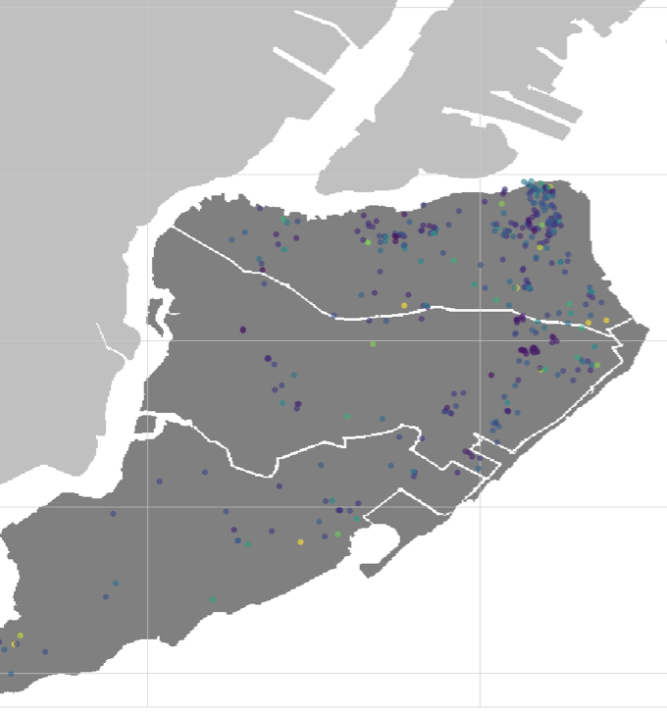
Bronx
Staten Island
mean price: 77.43
mean price: 89.23
 | train | test
Linear regression
RMSE | 39.02 | 40.51
XGBoost regressor
RMSE | 14.95 | 46.06
 | train | test
Linear regression
RMSE | 46.27 | 56.60
XGBoost regressor
RMSE | 5.53 | 62.61

Slide 23
14. Conclusions
Poor data quality and in particular uneven distributions of features made it difficult to build a good predictive model.
Multiple operations performed on given dataset did not bring any significant improvement in the obtained prediction of prices.
Deeper dive into given problem and extending dataset with more valuable feature manifesting better correlation with target could result in obtaining better predictions.

